Slide 1
Deep Neural networks Hyperparameter Tuning

Slide 2
Objective of DNN models
The keys success parameters for DNN are
Validation accuracy / accuracy of the model in production
Minimal computation requirements (CPU / GPU / TPU time, memory, storage)
Ease of implementing the model in production
To succeed in design and implementation of DNN model, an understanding of NN training as a non-convex optimization problem is a must
Due to lack of understanding the various aspects of DNN, practitioners make arbitrary choices for various hyperparameters, yielding potentially subpar performance.

Slide 3
Theoretical power of DNN
Theoretically, the deeper a neural network is, the more powerful it is
Deeper neural networks learn more coefficients / weights and hence become better universal approximators
Deep neural networks are more efficient in terms of coefficients than broad networks

Slide 4
Practical challenges in DNN
When the neural network becomes deep, the neurons in the initial layer(closest to the input layer) become slow / sluggish in learning
This is due to the vanishing gradient problem. Sometimes the opposite of it i.e. exploding gradients hamper the learnability of the neurons in the first few layers
As a result the neurons continue to hold on to the initial randomly assigned weights or slightly modified weights
Though the neural network may perform acceptably in training, it will perform poorly in production
This is because the first few layers are supposed to learn to extract the features from the input images. The learning process should optimize the weights
Optimization of weights means changing the randomly assigned weights to optimal weights. This does not happen due to vanishing gradient problem

Slide 5
Practical challenges in DNN
The neural networks can also easily become overfit when the number of weights to learn is too many while the input data is small
In such situation having too many layers, each with multiple neurons while the input data is limited is akin to too many parameters with low depth
The models become complex and overfit and will suffer in production from high degree of variance error
Thus, in summary, the challenge is how to create deep neural networks and avoid these challenges simultaneously
Solution : ….. Careful hyper parameter tuning…

Slide 6
DNN Model Capacity

Slide 7
Capacity / Underfitting / Overfitting
Informally, a model’s capacity is its ability to fit a wide variety of functions. It is the ability to express any kind of relation between the independent and target variables
Models with low capacity may struggle to fit the training set. Models with high capacity can overfit by memorizing properties of the training set that is of no use in test data
ML algorithms will generally perform best when their capacity is appropriate for the true complexity of the task they need to perform and the amount of training data they are provided with.

Slide 8
DNN – Parameters
In every model parameters are used to train the model and make predictions. There are however, two types of parameters… those that help learn (a.k.a hyper parameters and those that help predict (a.k.a. model parameters)
Hyperparameters come into play while the algorithm of choice is building the model. The objective is to make the model accurate and generalizable
Model parameters are the result of learning / model building and represent the learnt relationships between the target and predictor variables. They are used only for prediction

Slide 9
Deep Neural Network Hyperparameters
Hyper parameters & utilities
Number of hidden layers Number of neurons per layer Epoch, iterations and batch size Activation function Learning rate Loss functions and characteristics Optimizer and loss functions Weights initialization Dropout layers Batch normalization Early stopping ---------------------------------------- Softmax function Gridsearch

Slide 10
Number of Layers
The Input Layer
Every NN has exactly one layer of input neurons which are not really neurons. Some call it pass-thru neurons
The number of neurons comprising this layer, this parameter is completely and uniquely determined by the number of attributes in the training data
Other than these neurons, we may also have a neuron dedicated to hold the bias term
The Output Layer
Like the Input layer, every NN has exactly one output layer
Number of neurons is completely determined by the problem domain. Is it classification or regression case
If regression case, is the output a single value or a vector of values
If classifier, is it binary classification then need only one output node
or multi-class classification. Then will need as many nodes as many classes

Slide 11
Number of Hidden Layers
Conceptually, one hidden layer with multiple hidden nodes is equivalent of projection into higher dimensional space and it has been shown that it can model most complex functions fetching reasonable results
However, deep networks have a higher parameter efficiency than a shallow one. Parameter efficiency is number of parameters required to represent a function. A deep neural network can represent the same complex function with lesser neurons
Lesser the neurons, more the speed and less demanding on the computational resources. Overall the neural network can also get higher performance for the same number of neurons
Deep neural network take advantage of the hidden hierarchies in real world data where high level features consist of lower level features. E.g. a object consists of boundary, a boundary consist of sub-boundaries etc.
https://cs.stanford.edu/people/karpathy/convnetjs/demo/classify2d.html

Slide 12
Number of Hidden Layers (Contd…)
If we consider high level features as functions, these functions can be represented as sub-functions and sub-sub functions…. DNN have natural affinity towards such structured data
In many problems, we can start with just one or two hidden layers and get good results for e.g. 97% accuracy on MNIST dataset with one hidden layer and a few hundreds of neurons and get 98% accuracy with same number of neurons with two layers!
Gradually start increasing the number of layers and neurons while checking for overfitting the data
DL_Hyperparameter_Tuning.ipynb

Slide 13
Number of Neurons per Hidden Layer
Another knob we can turn is the number of nodes in each hidden layer.
This is called the width of the layer. Making wider layers tends to scale the number of parameters faster than adding more layers.
Every time we add a single node to layer i, we have to give that new node an edge to every node in layer i+1. This is akin to projecting data into higher dimensional space
For number of hidden layers, there is no thumb rule except the fact that deeper the network, more efficient the model becomes in terms of representing complex functions
But how many neurons per hidden layer? That is how to distribute the neurons across different layers. Some use the funnel approach where the mouth of the funnel is first hidden layer and the nozzle is the last hidden layer
The belief is… many sub features represented by the first few hidden layers can coalesce into higher features in the subsequent layer and hence less neurons in subsequent layer
Finding the right combination of the number of neurons in each layer is a challenge.

Slide 14
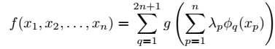
Number of Neurons per Hidden Layer (Theoretical approaches)
In 1957, Kolmogorov proved that any real-valued, continuous function ‘f()’ defined on a n-dimensional unit cube can be represented as the sum of continuous functions of a single variable
This is interpreted as 3 layer NN.
First layer is the input layer of n neurons
Second layer is the hidden layer consisting of 2n neurons (the outer loop). Each hidden neuron transforms the inner sum using a function ‘g’
The third layer is the output layer represented by the function f(x1, x2, x3 ,…)
In this three layer NN, λp is a constant and Ø is a linear function, p is number of dimensions of the cube
Hecht-Nielsen rephrased it to state that any continuous function f() defined on a n-dimensional unit cube can be implemented exactly by a 3 layer network with (2n + 1) hidden nodes
However, functions g and Ø are highly non-smooth unlike the sigmoid functions used in NN. Hence this theoretical interpretations should not be taken literally
The theorem does not tell us how to determine the number of neurons. It only mentions about the possibility of representing the function

Slide 15
Number of Neurons per Hidden Layer (Theoretical approaches)
More recently, Huang and Babri lowered these bounds, proving that an single hidden layer NN with at most Nh hidden neurons can learn Ns distinct samples with zero error. This is true for any bounded, non-linear activation function which has a limit at one, infinity. Thus the upper bound for SLFNs is Nh<= Ns
Huang later extended the work of Tamura and Tateshi to rigorously prove that the upper bound on the number of hidden nodes ,Nh for two hidden layer NN with sigmoid activation function is given by equation below, where No is the number of outputs. These can learn at least Ns distinct samples with any degree of precision
It is well known that functions which are linearly separable require no hidden nodes at all. For the rest, the discussions above indicate that within the constraints of their respective theorems, a function of any complexity can be reproduced with any degree of precision within the specified bounds.
However, if the training set contains noise, as is the case in most practical situations, exactly reproducing the training set will guarantee overfitting. This is undesirable
In practice therefore, the number of hidden nodes must necessarily be lower than these bounds and will depend on a number of specific factors such as degree of noise in data, complexity of the function we are modeling, number of inputs and outputs etc.
DL_Hyperparameter_Tuning.ipynb

Slide 16
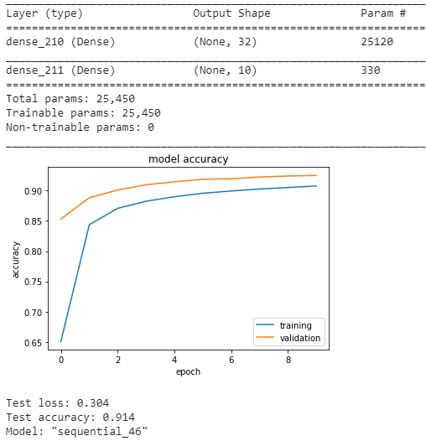
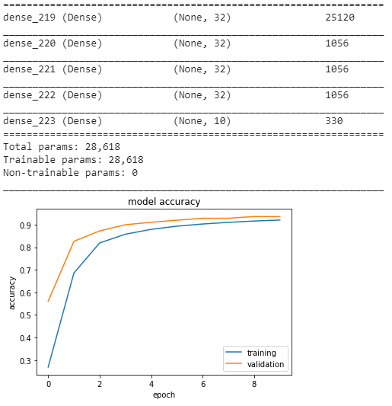
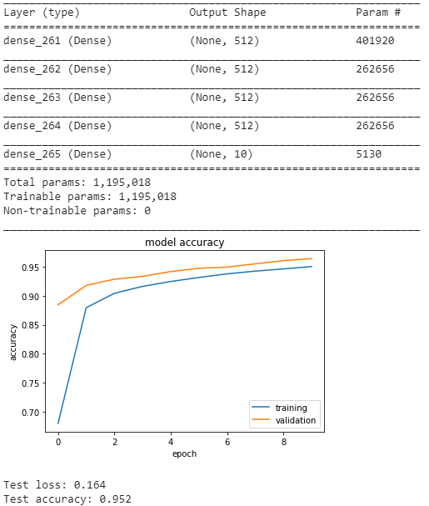
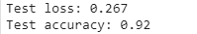
Number of Neurons per Hidden Layer
With increase in neurons for fixed number of layers, the accuracy improves
With increase in layers it improves further
Though in this data the training and validation accuracies seem to be converging, this cannot be taken as a general trend
When models overfit, there will be drop in the validation accuracy

Slide 17
Batch size
gradient descent hyper parameter to control the number of training samples to work through before the model’s internal parameters are updated
At the end of each batch, the error is calculated that is used to update the coefficients through back propagation
Batch Gradient Descent. Batch Size = Size of Training Set
Stochastic Gradient Descent. Batch Size = 1
Mini-Batch Gradient Descent. 1 < Batch Size < Size of Training Set
Memory requirements –
The more the RAM is available for training the better
Fix the batch size keeping in view the available memory
The larger the batch size, quicker the training
With larger batch size, lesser the chances of overfitting
The resulting model is likely to reflect realistic score

Slide 18
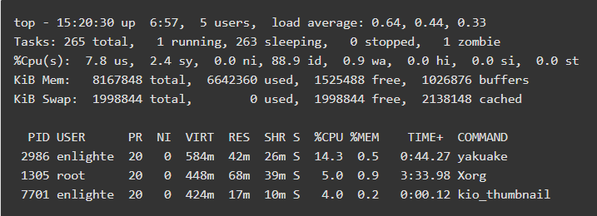
Batch size

Slide 19
Epochs
is a gradient descent hyperparameter that controls the number of complete passes through the training dataset
One epoch means that each sample in the training dataset is used once to update the coefficients
An epoch consists of one or more batches. An epoch that has one batch is called the batch gradient descent learning algorithm
Every epoch will consume CPU time, RAM and other computational resources
In every successive epoch the coefficients learnt in previous epoch will be fine tuned
However, in subsequent epochs the learning may flatten out i.e. no further fine tuning may happen but all the epochs will still be executed
Care should be taken that the number of epochs do not lead to overfitting
If the DNN architecture capacity is more than required, the epochs will lead to overfitting
We should use “Early Stopping” with Epochs to prevent overfitting and wastage

Slide 20
Activation Functions
The last step in a neuron is application of activation function. Choice of activation function decides the ANN learning capability. There are different activation functions
The entire power of an artificial neural network comes from the activation function. Without the activation function, the power of ANN collapses to that of a single neuron which cannot handle non linear classifications such as an XOR
The activation functions are non linear i.e. more than simple addition and multiplication which are linear functions. It is this non linearity that gives the artificial neural network its power to approximate any complex function
An activation function (what helps a neuron fire / activate) is a mathematical operation that takes as input a floating point number and returns a new floating point number
In the software implementation of ANN, we can have different activation functions for each layer but not for each neuron

Slide 21
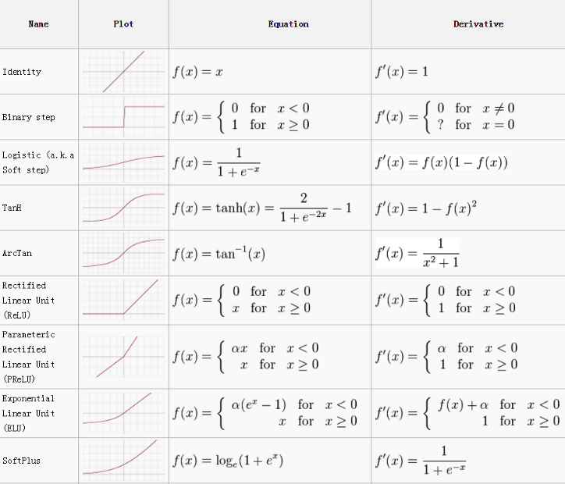
Activation Functions -

Slide 22
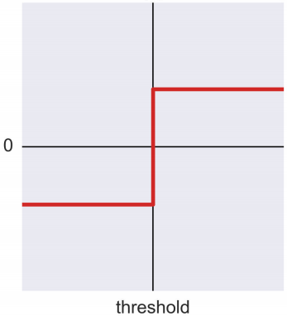
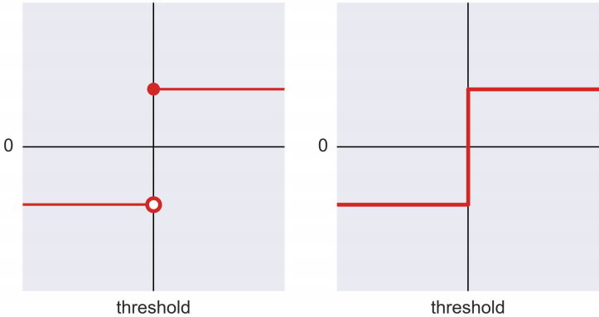
Activation Functions
Basic forms of activation functions include –
Linear functions –
the input floating point and output floating point numbers are linearly related and expressed in the form of y = mx + c
When activation functions are linear, they are only doing multiplication and addition and they are no use in ANN. They collapse the network into one single neuron
Stair Step functions –
When the function outputs a single value for a given range of input values and different but same value for subsequent range of values appears like steps
It is a combination of linear surface but still overall a non-linear function
Step function –
Function similar to Stair Step function but with only one step. Up until the threshold value the output is one value and on reaching the threshold it changes to another

Slide 23
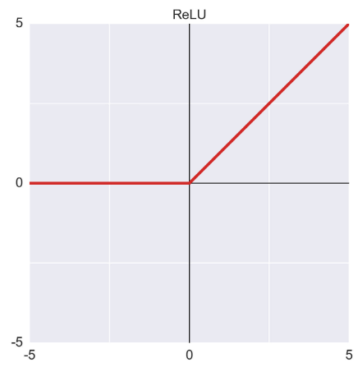
Activation Functions (Contd…)
Basic forms of activation functions include –
Piecewise Linear functions (ReLU)–
Activation function made of several functions each of which is a linear function, it is called piecewise linear. Overall it is still a non-linear function.
The most popular one being the ReLU (Rectified Linear Units). The names comes from electronics where a rectifier component prevents negative voltage passing through a circuit
If input is less than 0 (-ive) , output is 0. Otherwise the output is greater than 0
Output is a linear function of x after the kink
Fast to train and easy to implement but can run into problems for <0 inputs
Can lead to negative side of 0 on some weight updates.
That neuron will stop firing anything other than 0, literally it is dead
Variants of ReLU help overcome these limitations of ReLU

Slide 24
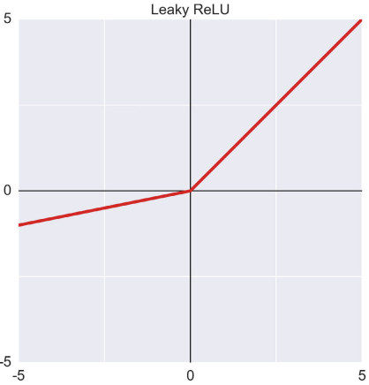
Activation Functions (Contd…)
Leaky ReLU–
Changes the response for inputs less than 0. Rather than output a 0 for negative inputs, it scales the output down by a factor of 10 for negative inputs
The factor can be changed from 10 (default) to other values in Parametric ReLU
Advantages
Leaky ReLUs are one attempt to fix the “dying ReLU” problem by having a small negative slope (of 0.01, or so).
Disadvantages
As it possess linearity, it can’t be used for the complex Classification. It lags behind the Sigmoid and Tanh for some of the use cases.

Slide 25
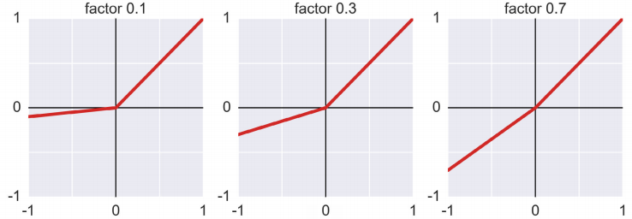
Activation Functions (Contd…)
Parametric ReLU-
1. Do not change the parameter to 1 as that will remove the kink

Slide 26
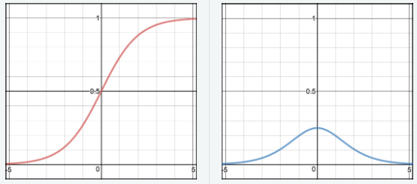
Activation Functions (Contd…)
Sigmoid / Logistic function / curve –
It outputs a value less than .5 for every negative input and greater than .5 for every value greater than 0
The least value it can output approaches 0 at negative infinity and the max value it can output approaches 1 at positive infinity
suffer from vanishing gradient and exploding gradient problem
Advantages
It is nonlinear in nature i.e. it projects a linear data set into non-linear space
It will give a continuous derivable activation unlike step function.
Suitable for classification as it maps to probability range 0 - 1
Squashes input values into a range of 0 – 1 hence output is never too large in magnitude
Disadvantages
On the extremes of X, the output tend to respond very less to changes in X (small gradients)
It gives rise to a problem of “vanishing gradients”. Sigmoids saturate and kill gradients.
As the gradient curve (blue) for the Sigmoid is almost flat, any change in the change in the gradient will have very low impact on the output
The network refuses to learn further or is drastically slow ( depending on use case and until gradient /computation gets hit by floating point value limits (explosion) ).

Slide 27
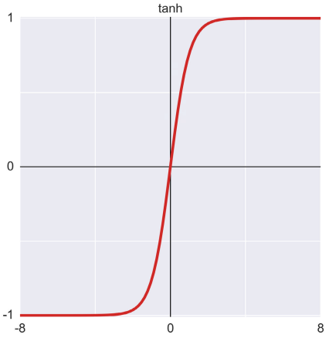
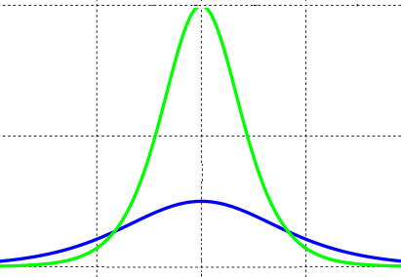
Activation Functions (Contd…)
Hyperbolic Tangent / tanh –
Similar to logistic but main difference is for negative inputs, the least value output approaches -1 at negative infinity
At 0 input value the output is also 0. suffer from vanishing gradient and exploding gradient problem
The Sigmoid and tanh functions squash the input values to a range of values between (0,1) and (-1 , 1) respectively
Advantages
The gradient is stronger for tanh than sigmoid ( derivatives are steeper).
Disadvantages
Tanh also has the vanishing gradient problem.
Tanh
Sigmoid
Gradient comparison

Slide 28
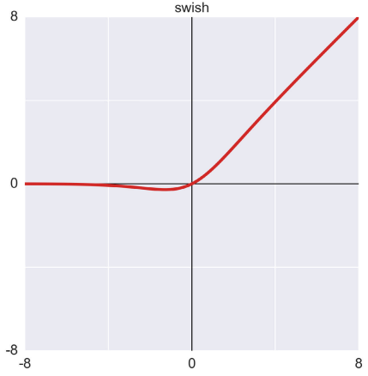
Activation Functions (Contd…)
Swish –
Combination of the sigmoid and basic ReLU function. In essence it is ReLU with a small bump to the left of 0 which flattens out over more and more negative values
Drawback of smooth functions is they produce useful results in a small range of input values where the gradients can be meaningfully calculated.
At extreme input values the gradients flatten out which leads to a problem in learning process

Slide 29
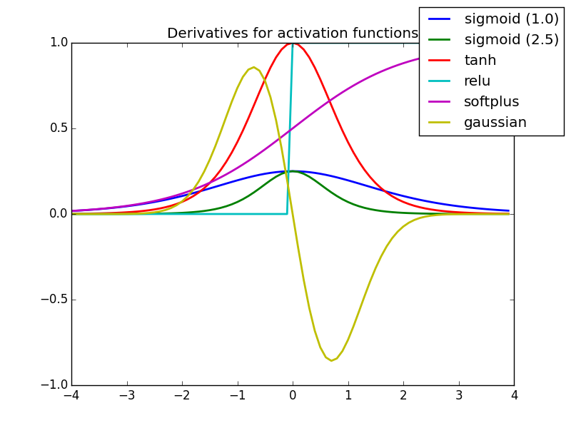
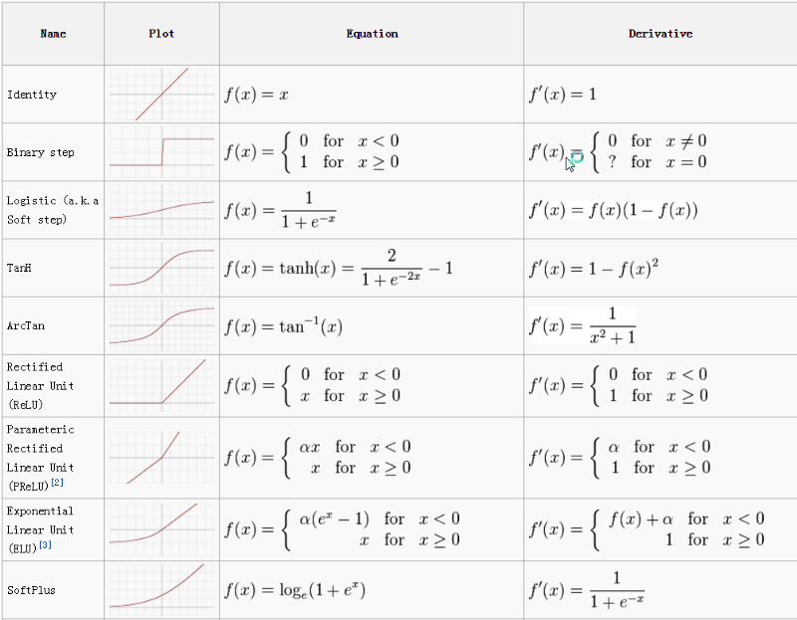
Activation Functions (Contd…)
Note the derivative of Sigmoid. It is maxing at .25 and almost flat for a major part of its function. That means smaller
Fig Ref: https://towardsdatascience.com/activation-functions-neural-networks-1cbd9f8d91d6

Slide 30
Activation Functions (Contd…)
Which activation function to use?
Sigmoid function use to be popular at the beginning of the work on neural networks. However, due to the vanishing and exploding gradient problem, it has fallen out of favor
Instead ReLU and it’s variants are often used in deep learning in the hidden layers
Softmax function for output layer in case of classification problems and a linear function if it is a regression problem
Ref: https://keras.io/activations/
DL_Hyperparameter_Tuning.ipynb

Slide 31
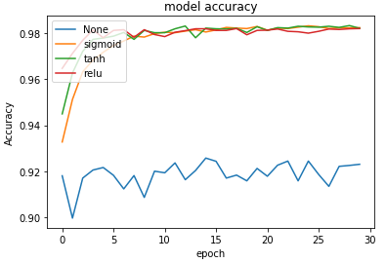
Activation Functions (Contd…)
The blue line is for a linear function and surprisingly it is giving 92% + accuracy!
However, all the other standard activations ReLU, tanh, Sigmoid are performing relatively much better
All converge to same 98% +- accuracy score
Any further increase in epochs may not help as all of them stop increasing beyond
Sigmoid is the slowest learner followed by tanh while ReLU seems to learn fast.... (Why ?)
The different non-linear activation functions deliver the same end result, the difference is in how fast they learn
There is no one single best activation function. Each can give relatively better performance under different conditions

Slide 32
Learning Rate
In order for Gradient Descent to work efficiently especially when error surface is complex, we set the λ (learning rate). This parameter determines how quickly the optimal values of the coefficients are found
The learning rate hyperparameter controls the magnitude of change in the parameter weights in the gradient descent
A learning rate that is too small leads to slow convergence, while a learning rate that is too large can hinder convergence and cause the loss function to fluctuate around the minimum or even to diverge (explode)
Adjusting the learning rate - adjust the learning rate during training by e.g. annealing, i.e. reducing the learning rate according to a pre-defined schedule or when the change in objective between epochs falls below a threshold.
These schedules and thresholds, however, have to be defined in advance and are thus unable to adapt to a dataset’s characteristics
Additionally, the same learning rate applies to all parameter updates. If our data is sparse and our features have very different frequencies, we might not want to update all of them to the same extent, but perform a larger update for rarely occurring features
Another key challenge of minimizing highly non-convex error functions common for neural networks is avoiding getting trapped in their numerous suboptimal local minima.

Slide 33
Learning Rate - Tuning
Configure the learning rate with sensible defaults
Assess the impact of learning rate – is it acceptable or is it stuck (unable to learn)
Perform sensitivity analysis by jiggling the learning rate
Improve performance with learning rate schedules, momentum, and adaptive learning rates.
DL_Hyperparameter_Tuning.ipynb
https://towardsdatascience.com/understanding-learning-rates-and-how-it-improves-performance-in-deep-learning-d0d4059c1c10
https://arxiv.org/abs/1704.00109 (Stochastic weight averaging method)

Slide 34
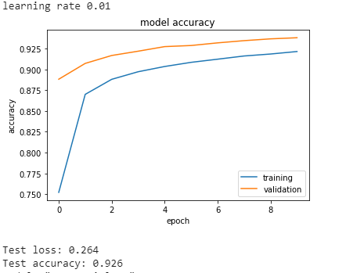
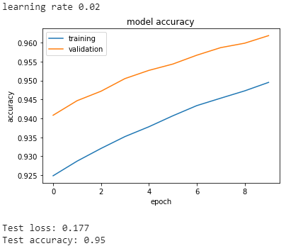
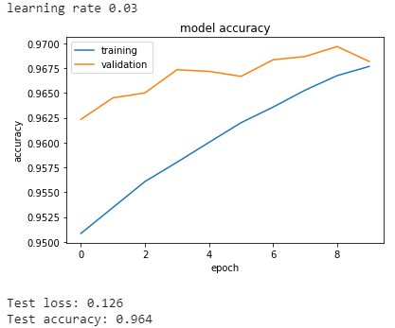
For small learning rate… the accuracy is low and apparently increases with higher learning rate
Lower learning rate will need more epochs as the learning slow. Hence within the given number of epochs it appear to give low accuracy that increases with higher learning rate.
Error surface looks relatively smooth. With higher learning rate, even with few epochs the network reaches high accuracy and the training and validation accuracy converge
Given the cleansed data, this will not always be the case. Usually the validation and training scores will deviate due to overfit.

Slide 35
Loss Functions
Regression Loss Functions
Mean Squared Error Loss
Mean Squared Logarithmic Error Loss
Mean Absolute Error Loss
Binary Classification Loss Functions
Binary Cross-Entropy
Hinge Loss
Squared Hinge Loss
Multi-Class Classification Loss Functions
Multi-Class Cross-Entropy Loss
Sparse Multiclass Cross-Entropy Loss
Kullback Leibler Divergence Loss

Slide 36
Large Computational Requirement
Error Function Basics in one dimension
Global& local minima
Local maxima
Flat regions
Objective : find a threshold that minimises misclassification
Global Maxima
Error Magnitude
Local Maxima
Local Minima
Global Minima & flat region
Threshold

Slide 37
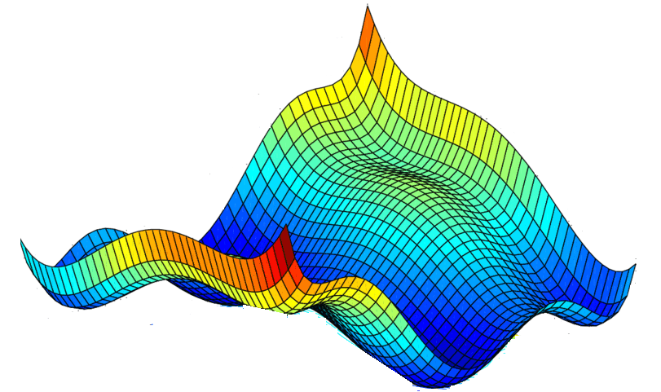
Large Computational Requirement
Error Function Basics in two dimensions
Combined error surface in two dimesions
Coeff2
Coeff1
Coeff1
Two error curves on respective coefficients

Slide 38
Large Computational Requirement
We do not know how the error function is! We only know what local gradients look like
This is like feeling your way down to the valley from hill top in thick fog!

Slide 39
Large Computational Requirement
That means, depending on the starting point, the paths taken and destination may be different!
If we evaluate all the points and evaluate the gradients, we will get complete picture of the error surface but this is not possible
Thus, the objective is, irrespective of starting point, reach the absolute minima on the invisible surface

Slide 40
Large Computational Requirement
Flat regions
Local maxima
Local Minima
Saddle point
Global Minima
Flat regions have very low gradients. As a result, the search for minima will slow down (sometimes significantly)
Local minima is a point surrounding which are points with higher error. Once that point is reached, there is no way to get out!
Saddle point is the point which is local maxima in one direction and local minima in other direction
Global minima is the sought goal that may or may not be reached. Depends on where the journey began

Slide 41
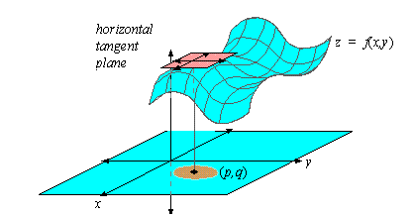
Gradients of the error function

Slide 42
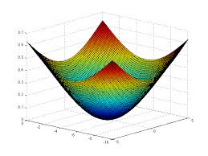
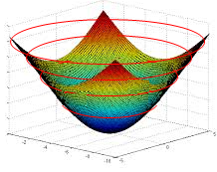
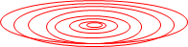
Error Contours
Every ring on the error function represents a combination of coefficients (m1 and m2 in the image) which result in same quantum of error i.e. SSE
Let us convert that to a 2d contour plot. In the contour plot, every ring represents same magnitude of error.
The innermost ring / bull’s eye is the combination of the coefficients that gives the least error
m2
m1

Slide 43
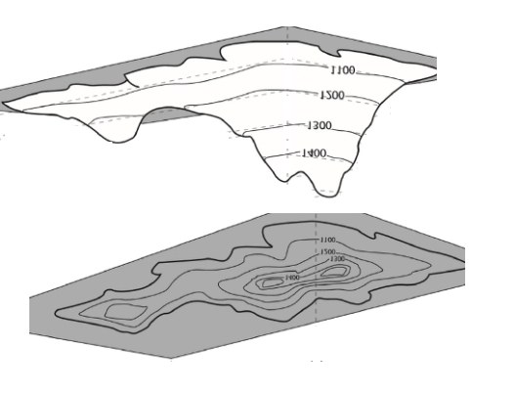
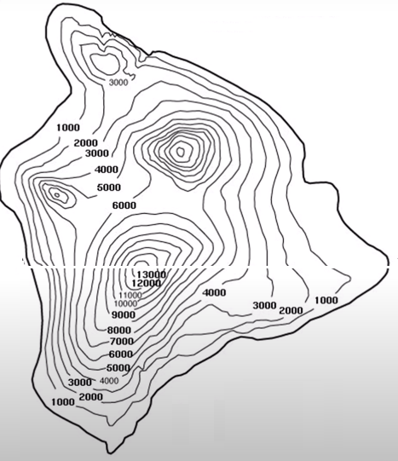
Contours of non-conovex error functions

Slide 44

Randomly selected starting point
Gradient Descent Steps –
First evaluate dy(error)/d(weight) to find the direction of highest increase in error given a unit change in weight (Blue arrow). Partial derivative w.r.t. to weight
Next find dy(error) /d(bias) to find the direction of highest increase in error given a unit change in bias (green arrow). Partial derivative w.r.t. to bias
Partial derivatives give the gradient in the given axis and gradient is a vector
Add the two vectors to get the direction of gradient (black arrow) i.e. direction of max increase in error
We want to decrease error, so find negative of the gradient i.e. opposite to black arrow ( Orange arrow). The arrow tip is new value of bias and weight.
Recalculate the error at this combination an iterate to step 1 till movement in any direction only increases the error
B1
W1
Bias
weight
Gradient vector

Slide 45
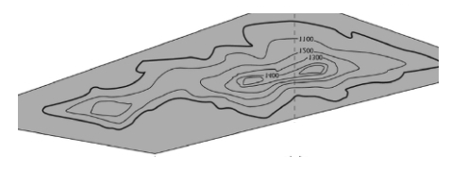
Random Starting coefficient values

Slide 47
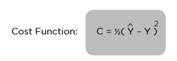
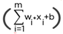

Loss function – Sum of Squared Errors
What is an optimization algorithm and what is its use? - Optimization algorithms helps us to minimize (or maximize) an Objective function (another name for Error function) E(x) which is simply a mathematical function dependent on the Model’s internal learnable parameters which are used in computing the target values(Y) from the set of predictors(X) used in the model
C = ½(( wi.xi + b) – y). In this expression Xi and y come from the data and are given. What the ML algorithm learns is the weight wi and bias b. Thus C = f( wi, b)
The optimizer algorithms try to estimate the values of wi and b which when used will give minimum or maximum C. In ML we look for minimum

Slide 48
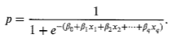
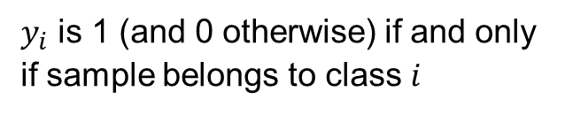
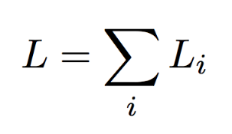
Loss function – Cross Entropy
Cross-entropy loss (often called Log loss) increases as the predicted output diverges from actual output
Perfect prediction would have a log loss of 0
Gradient descent tries to reduce this cross-entropy loss
Sum loss over entire dataset i.e. i = 1 to n

Slide 49
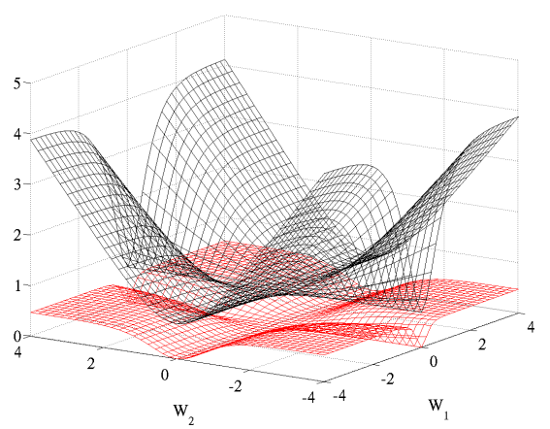
Loss function – Error surface and gradients
Logistic regression or conditional log-likelihood cost function (− log P(y|x) coupled with softmax outputs) worked much better (for classification problems) than the quadratic cost which was traditionally used to train feedforward neural networks
Ref: http://proceedings.mlr.press/v9/glorot10a/glorot10a.pdf
Black surface – Logistic cost function, has huge gradients
Red surface – quadratic cost function, is mostly flat
Both loss functions will give similar accuracies but logistic cost function will be faster in reaching the minima than quadratic function due to the difference in the flatness of the surfaces
Image source - http://proceedings.mlr.press/v9/glorot10a/glorot10a.pdf

Slide 50
Optimizer for cost / loss function
There are two broad categories of optimization algorithms –
First Order Optimization Algorithms —
These algorithms minimize or maximize a function E(x) using concept of gradient of cost function w.r.t to learnable parameters.
Gradient descent is the default choice in most applications of machine learning models and the function is a loss function a.k.a. cost function
The First order derivative tells us whether the cost function increases or decreases at a particular value of the learnable parameters
First order Derivative basically give us a line which is Tangential to a point on its Error Surface
A Gradient is represented by a Jacobian Matrix — which is simply a Matrix consisting of first order partial Derivatives(Gradients).
Second Order Optimization Algorithms —
Second-order methods use the second order derivative which is also called Hessian to minimize or maximize the Loss function
The second order derivative tells us whether the first order derivative is at maximum or minimum of the cost function when it is 0
This is not used as frequently as gradient descent due to computation requirements
https://web.stanford.edu/class/msande311/lecture13.pdf

Slide 51
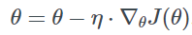
Optimizer for cost / loss function
First Order Optimization Algorithms -
Batch Gradient Descent (default) –
The most common vanilla version being the batch gradient descent.
Computes the gradient of the cost function w.r.t to the model parameters for the entire data set before updating the parameters.
Many data points may have errors, all the errors averaged and change in m parameter is the avg SSE / avg of x
Batch gradient descent is slow, computationally intensive, guaranteed to reach absolute minima in convex functions
We can introduce randomness in the gradients to fasten up things as in SGD
for i in range(no_of_epochs): # for every epoch
parameterwise_gradient = evaluate_gradient(loss_function, data, params) # evaluate gradient using
# partial differentiation
params = params - learning_rate * parameterwise_gradient # update parameters

Slide 52
Gradient Descent variants
Stochastic Gradient Descent (SGD) –
In every iteration, a randomly chosen record is picked up to refine the parameters
Updates the parameters for each training example of xi and yi.
Relatively faster to compute but the parameters fluctuate and may take long to converge
You can imagine the point on the error function moving haphazardly towards the minimum
Non-convex error functions with saddle points and local minima become difficult to get out of
Practically very time consuming and resource intensive compared to mini-batch and batch gradient descent algorithm
for i in range(no_of_epochs): # for every epoch
for record in given data:
parameterwise_gradient = evaluate_gradient(loss_function, record, params) # evaluate gradient
#using partial diff
params = params - learning_rate * parameterwise_gradient # update parameters

Slide 53
Gradient Descent variants
Mini Batch Gradient Descent –
Takes best of the both batch and stochastic GD. Performs update for a mini batch of n input samples
Leads to faster and more stable convergence to minima compared to batch GD and Stochastic GD on non-convex surface
Does not guarantee optimal convergence
for i in range(no_of_epochs): # for every epoch
for batch in make_batch(data, batch_size=50)
parameterwise_gradient = evaluate_gradient(loss_function, data, params) # evaluate gradient
#using partial diff
params = params - learning_rate * parameterwise_gradient # update parameters

Slide 54
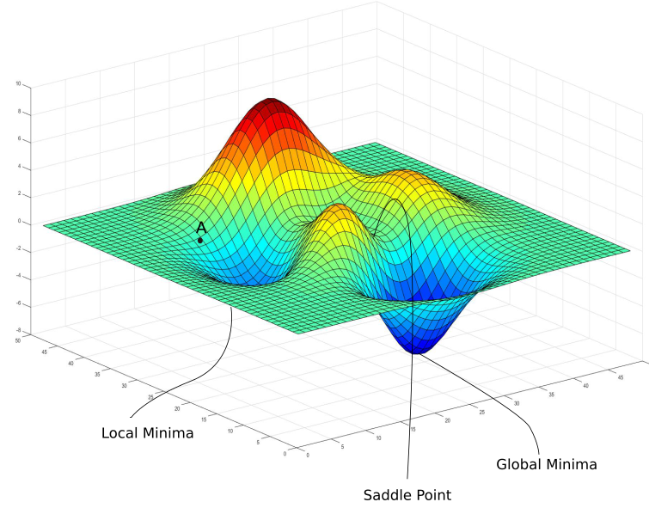
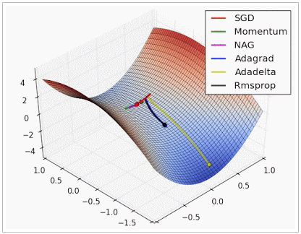
Error surface characterisitcs & Challenges of Gradient Descent algorithm
Local minima - for non-convex error functions, the gradient descent algorithm can get stuck into a local minima i.e. sub-optimal combination of the parameters that gives an impression of having minimized the errors to the possible
Saddle points – The algorithm may reach a saddle point where there are relatively no or very little gradients (flat regions) where the algorithm stops to learn!
Even with learning rates, such challenges may make the gradient descent inefficient as the learning rates are not determined from the data
Error Function
Error
Parameter 1
Parameter 2
http://www.denizyuret.com/2015/03/alec-radfords-animations-for.html

Slide 55

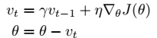
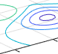
Gradient Descent optimization algorithms
Momentum –
SGD finds it difficult to handle situations where the error surface gradients is different in each direction. Steep in one while shallow in other. In such cases it oscillates across the slopes of the ravine making slow progress towards the local optima
Momentum helps accelerate the SGD towards the relevant minima quickly. It adds a fraction of the update vector (combination of the gradient) of previous step to the current update step.
Momentum – fraction of the previous step gradient added to new gradient
The momentum term increases for dimensions whose gradients point in the same directions and reduces updates for dimensions whose gradients change directions. As a result, we gain faster convergence and reduced oscillation.

Slide 56
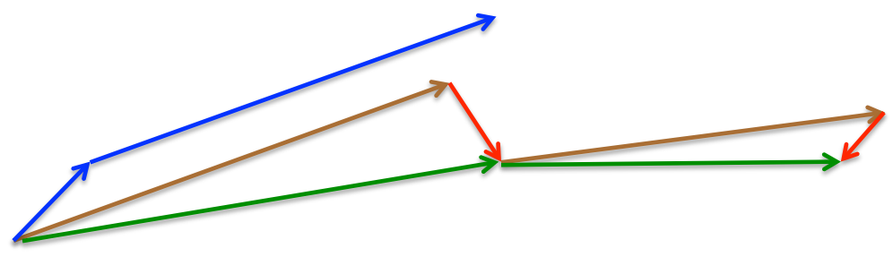
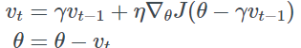
Gradient Descent Optimization Algorithms
Nesterov Accelerated Gradient (NAG)-
Tries to build intelligence into the updating step based on approximate future parameter values
Unlike momentum, this algorithm estimates parameters based on the momentum from previous step and applies the gradient there to find the final position
It slows down the movement when approaching a higher gradient i.e. in increasing slope in error
Source: G. Hinton's lecture 6c
Gradient at future step(B)
Result of momentum
NAG first jumps in direction of accumulated momentum from previous step (A)
Resulting gradient at current step (C = A+B)
C
A
B
Current position

Slide 57
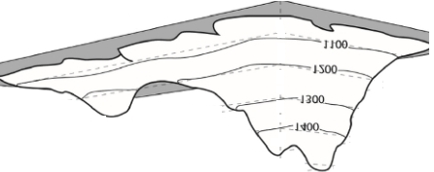
Gradient Descent Optimization Algorithms
Adagrad –
D2
D1
lsd1
lsd2
result
At point P, the gradient in D1 direction is much higher than in D2
Why should the learning step be same in both directions
Would it not be advantageous to have larger learning step in D2 direction and small steps in D1

Slide 58
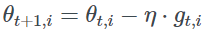
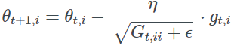
Gradient Descent Optimization Algorithms
Adagrad –
Adapts learning rate to the individual parameters rather than using a single learning rate for all
Performs larger updates for infrequent parameters and smaller updates for frequent parameters
Other methods perform an update for all parameters θ at once as every parameter θi used the same learning rate η
As Adagrad uses a different learning rate for every parameter θi at every time step t
g(t,i) is partial derivative of the objective function w.r.t. to the parameter θi at time step t
The SGD update for every parameter θi at each time step t then becomes
But Adagrad modifies the general learning rate η at each time step t for every parameter θi based on the past gradients that have been computed for θi
Source : http://www.deeplearningbook.org/contents/optimization.html

Slide 59
Gradient Descent Optimization Algorithms
Adagrad –
individually adapts the learning rates of all model parameters by scaling them inversely proportional to the square root of the sum of all the historical squared values of the gradient
The parameters with the largest partial derivative of the loss have a correspondingly rapid decrease in their learning rate, while parameters with small partial derivatives have a relatively small decrease in their learning rate.
The net eﬀect is greater progress in the more gently sloped directions of parameter space. In the context of convex optimization, the AdaGrad algorithm enjoys some desirable theoretical properties.
Empirically, however, for training deep neural network models, the accumulation of squared gradients from the beginning of training can result in a premature and excessive decrease in the eﬀective learning rate. AdaGrad performs well for some but not all deep learning models
Source : http://www.deeplearningbook.org/contents/optimization.html

Slide 60
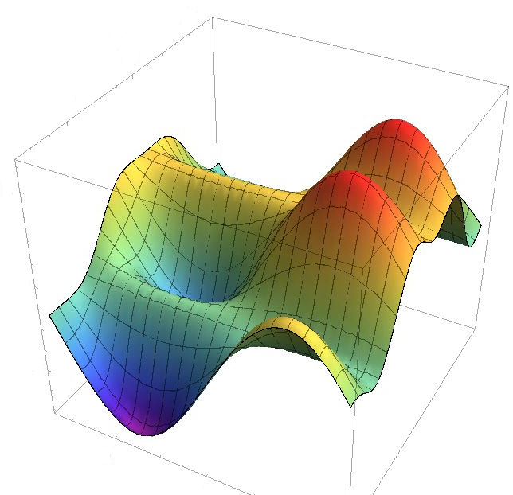
Gradient Descent Optimization Algorithms
Adagrad (Contd) –
As Adagrad uses a different learning rate for every parameter θi at every time step t
Drawback of Adagrad is rapidly monotonically shrinking learning rate for certain frequently occurring parameters
Error
Diagonal matrix for two parameter space with elements i,i as sum of square of gradients of parameter pi upto the time step t
Error term is added to prevent divide by 0 error. This is like the standard deviation of gradient for pi
Parameter 2
Parameter 1
Learning step has to be regularized from the default eta based on the under root quantity. Too frequently updated gradient will need small steps while rarely changing gradient will need large steps (the under root will be close to error term)

Slide 61
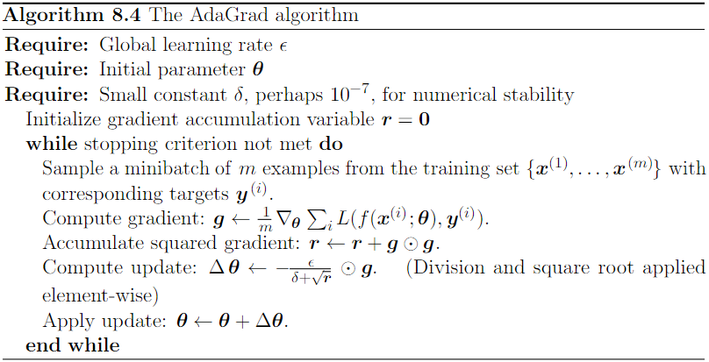
Gradient Descent Optimization Algorithms
AdaGrad –
Source : http://www.deeplearningbook.org/contents/optimization.html

Slide 62
Gradient Descent Optimization Algorithms
RMSProp –
modiﬁes AdaGrad to perform better in the nonconvex setting by changing the gradient accumulation into an exponentially weighted moving average. AdaGrad is designed to converge rapidly when applied to a convex function. When applied to a nonconvex function to train a neural network, the learning trajectory may pass through many diﬀerent structures and eventually arrive at a region that is a locally convex bowl
AdaGrad shrinks the learning rate according to the entire history of the squared gradient and may have made the learning rate too small before arriving at such a convex structure
RMSprop and Adadelta came out independently around the same time stemming from the need to resolve Adagrad's radically diminishing learning rates.
RMSprop (proposed by Geoff Hinton) in fact is identical to the vector of Adadelta
Source : http://www.deeplearningbook.org/contents/optimization.html

Slide 63
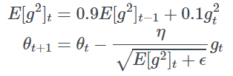
Gradient Descent Optimization Algorithms
RMSProp –
RMSprop (proposed by Geoff Hinton) in fact is identical to the vector of Adadelta
RMSProp uses an exponentially decaying average to discard history from the extreme past so that it can converge rapidly after ﬁnding a convex bowl, as if it were an instance of the AdaGrad algorithm initialized within that bowl
RMSprop divides the learning rate by an exponentially decaying average of squared gradients. Hinton suggests γ to be set to 0.9, while a good default value for the learning rate η is 0.001.
Source : http://www.deeplearningbook.org/contents/optimization.html

Slide 64
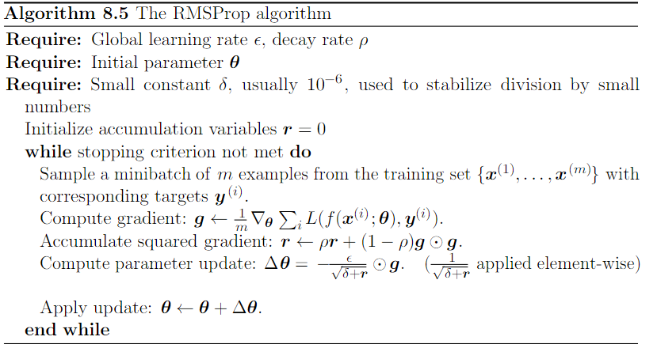
Gradient Descent Optimization Algorithms
RMSPROP –
Source : http://www.deeplearningbook.org/contents/optimization.html

Slide 65


Gradient Descent Optimization Algorithms
Adadelta –
Ada delta attempts to overcome the Adagrad rapidly shrinking learning rate by defining a time window to accumulate past gradients instead of taking all
Instead of inefficiently storing all past w window gradients, sum of gradients is recursively defined as decaying average of all past gradients
The running average E [(g^2)t ] at time t depends on a fraction of previous average and current gradient
Thus change in parameters is given as -

Slide 66

Gradient Descent Optimization Algorithms
Adam –
Stands for adaptive moments
Adds a momentum term to RMSProp rescaled gradients
Source : http://www.deeplearningbook.org/contents/optimization.html

Slide 67



Gradient Descent Optimization Algorithms
SGD
RMSProp
Adam
Choosing the right optimization technique –
There is currently no consensus
Some empirical studies favor algorithms with adaptive learning rates but no single algorithm emerged as the best
Most popular ones – RMSProp, RMSProp with momentum , AdaDelta, Adam, SGD with momentum, SGD

Slide 68
Weights Initialization
This concerns with the first set of weights that are assigned at the start of the training stage. These weights used to be randomly assigned in early days of DNN.
Weights were generated from a uniform random distribution. This means take all values between two extremes with equal probability. Though the weights are assigned randomly, they are expected to converge thru the learning process to optimal values
Normal initialization using normal distribution – also known as Gaussian distribution of random numbers. In this approach weights drawn randomly are likely to be from closer to the central value i.e. 0. 0 is most likely! The random values are replaced with optimal values through learning process
Three well researched strategies for initial weight selection include LeCun uniform, Glorot (a.k.a Xavier) uniform, He uniform algorithms to draw from uniform distribution and similarly normal distribution i.e. LeCun Normal, Golrot Normal, He Normal
Ref:
https://keras.io/initializers/
https://towardsdatascience.com/hyper-parameters-in-action-part-ii-weight-initializers-35aee1a28404

Slide 69
Weights Initialization and problem of vanishing and exploding gradients
It was empirically observed that DNN often suffered from unstable gradients, suddenly grow too big (the hardware registers unable to hold leading to “Nan”, or the gradients become close to 0 or even 0)
This behavior of the DNN made them difficult to train and DNN was almost abandoned. In 2010 Xavier Glorot and Yoshua Bengio published a paper explaining the reason behind these problems. http://proceedings.mlr.press/v9/glorot10a/glorot10a.pdf
They suspected the popular non-linear activation function (Sigmoid) and Tanh combined with the random weight initialization using normal distribution centered at 0 with standard deviation of 1.
They showed that under this approach the variance of the output of a hidden layer becomes greater and greater than the variance of the input of that layer. Going forward in the network the variance keeps increasing
The activation functions in the last few layers / top layers saturate i.e. reach the flat regions of their sigmoid functions given the magnitude of the inputs
As a result, when the back propagation kicks in, the error gradients in the top layers are small and when these small error gradients are propagated back, they tend to become smaller and smaller!

Slide 70

Weights Initialization and problem of vanishing and exploding gradients
In each subsequent layer the activation function (Sigmoid) is reaching saturation point i.e. the inputs are becoming large in magnitude (due to increase in variance) leading the output close to a constant 0 or 1 (regions of very tiny gradients i.e dy/dx is almost 0)

Slide 71



Weights Initialization and problem of vanishing and exploding gradients
Graident of a sigmoid function
The sigmoid function and tanh have flat slope for most of the values of X. That means for most of the values of the change in the function i.e. d(𝜎(x) / d(x)) will be close to 0 as can be seen in the red dashed curve (plot of derivative of sigmoid function)
The max value for the derivative of sigmoid is .25, i.e. 1/4th , a small fraction
In the flat regions, the derivative will be very small, close to 0 as it is almost flat there. When stuck in such regions, the change in weights (look at the formula below) is very small or 0 i.e. the learning stops
$W^{New }$ = $W^{Old }$– ὴ(d(E)/d(w))
Notes:
The input layer is passive, does no processing, only holds the input data to supply it to the first hidden layer
In the hidden layer, each node extracts all the input values from the input layer
While extracting the values from input layer, each hidden node multiply the values with appropriate weights and sum up
The summed value is further processed through a sigmoid function.

Slide 72
Weights Initialization and problem of vanishing and exploding gradients
Neuron Chain Equation for weight learning
One neuron with a linear function followed by a nonlinear transformation to ouput O
Error is a function of (O and Y). Since Y is constant (comes from data), only O can change
Thus rate of change of E with respect to O is d(E)/ d(O)
But O is a function of nonlinear transformation NLF(). Thus rate of change of O = d(O)/d(NLF())
The non linear function is dependent on linear function hence rate of change of NLF() = d(NLF())/D(LF())
Linear function is dependent on the input
Thus the overall impact of change in i over E i.e. d(E) / d(i)
v
I
O
E = f(O,Y)
LF() / NLF()
D(E) / d(i) =
D(LF()) / d(i)
d(NLF()) / d(LF())
d(O) / d(NLF())
D(E) / d(O)
*
*
*

Slide 73

Weights Initialization and problem of vanishing and exploding gradients
Chains across layers
i1
v
O1 = i2
v
O
E = f(O,Y)
LF()1 / NLF()1
LF()2 / NLF()2
d(E) / d(i1) =
d(LF()1) / d(i1)
*
d(NLF()1) / d(LF()1)
*
d(i2) / d(NLF()1)
*
D(LF()2) / d(i2)
*
d(O) / d(NLF()2)
D(E) / d(O)
*
d(NLF()2) / d(LF()2)
*
As we add more and more layers to a neural network (make it deeper), the chain equation extends across layers as shown above
The chain of equations with multiplication operator helps estimate the effect on E of a change in i1
i1 is the input to the first neuron which is the input value multiplied by a coefficient / slope (not shown separately)
Similarly, i2 is the output of first neuron multiplied by a coefficient (not shown separately)
As a result of this chain, there is a possibility of fractions appearing in the equations either because of the random values of slope fixed in first iteration and due to the derivation of the non-linear function.
If the non linear function is a sigmoid or Tanh function, fractions are guaranteed on derivation
Fractions multiply to give smaller fractions and as a result, the d(E) / d(i1) i.e. change in overall error for a change in inputs of first layer neuron becomes very very small in magnitude leading to no significant change in the coefficient
Note: change in coef at any stage is $W^{New }$ = $W^{Old }$– ὴ(d(E)/d(w))

Slide 74

Weights Initialization and problem of vanishing and exploding gradients
Combination of chain effect
Replace the unitary NN with multi-layer multi-neuron network as shown below
The error at every layer will be E (same as error in the final layer)
However, the E will be proportionally assigned to each neuron in layer
Hence, we are interested in estimating the impact of change in each neuron’s input on the overall E at that level
The chain rule will structurally be similar but will have more terms for each neuron at each layer given multiple connection from a node to nodes in subsequent layer . For e.g. at node 1,1
d(E) / d(i1) = d(lf()1) / d(i1) * d(nlf()1)/d(lf()1) * d(i2)/d(nlf()1) * d(lf()2)/d(i2) * d(nlf()2/dlf()2) * d(O)/d(nlf()2) * d(E)/d(O)
+
d(E) / d(i2) = d(lf()1) / d(i2) * d(nlf()1)/d(lf()1) * d(i2)/d(nlf()1) * d(lf()2)/d(i2) * d(nlf()2/dlf()2) * d(O)/d(nlf()2) * d(E)/d(O)
+
d(E) / d(i3) = d(lf()1) / d(i3) * d(nlf()1)/d(lf()1) * d(i2)/d(nlf()1) * d(lf()2)/d(i2) * d(nlf()2/dlf()2) * d(O)/d(nlf()2) * d(E)/d(O)
i1
i2
i3
E
E
Notes:
The input layer is passive, does no processing, only holds the input data to supply it to the first hidden layer
In the hidden layer, each node extracts all the input values from the input layer
While extracting the values from input layer, each hidden node multiply the values with appropriate weights and sum up
The summed value is further processed through a sigmoid function.

Slide 75
Weights Initialization and problem of vanishing and exploding gradients
Vanishing Gradient in long chains
Fractions can appear in the chain equation at any layer
Fractions can be caused by the derivatives of the non linear functions (if the non linear function is a tanh or sigmoid) when the same is computed in the flat regions of the function
We end up in the flat regions of the sigmoid / tanh functions when the input to the non linear transformation (output of the linear transformation) is very small or very large in magnitude. Remember , in every neuron we first have linear transformation whose output is passed to non linear function
The output of linear transformation can be very high or very small when the random weights assigned in the first iterations
If the random weights are too large, leading to a large value for mx+c, this will position the output value in the flat region of the non-linear curve (near to 1).
If the random initialization a small number (negative value), it position the output in the flat region of the non-linear transformation near 0

Slide 76

Weights Initialization and problem of vanishing and exploding gradients
Xavier and He weight initialization methods
Glorot and Bengio argued that for signal to flow properly in both directions (not die out or explode) we need to ensure variance of outputs of each layer to be equal to the variance of the inputs. Also the gradients should have equal variance before and after a layer in backprop
This is possible only if the layer has an equal number of input and output connections. Since this restrains the design, they proposed a compromise that works in practice
The connection weights must be initialize randomly as per the equation below… where ni and ni+1 are the number of input and output connections for the layer, also called fan-in and fan-out
Ref: https://www.deeplearning.ai/ai-notes/initialization/

Slide 77


Weights Initialization and problem of vanishing and exploding gradients
Xavier and He weight initialization methods
With Xavier initialization
Credit: Glorot & Bengio.
Without Xavier initialization
Without Xavier init. Credit: Glorot & Bengio.

Slide 78

Weights Initialization and problem of vanishing and exploding gradients
Vanishing gradient – possible solutions to minimize chance of getting stuck in vanishing gradient
Do not initialize the weights with zeroes or randomly
If the weights in a network start too small, the feed into the non-linear functions become too small (as discussed earlier), can lead to flatter regions
If the weights in a network start too large, the feed into the non-linear functions become too large leading to flatter regions again
Use Xavier initialization technique - initializes the weights in your network by drawing them from a distribution with zero mean and a specific variance
Fan_in is number of input connections into a neuron
It draws samples from a truncated normal distribution centered on 0 with stddev = sqrt(1 / fan_in)
Generally used with tanh activation

Slide 79


Weights Initialization and problem of vanishing and exploding gradients
Vanishing gradient – possible solutions to minimize chance of getting stuck in vanishing gradient
Use He Normal - In this method, the weights are initialized keeping in mind the size of the previous layer which helps in attaining a global minimum of the cost function faster and more efficiently.
Unlike in Xavier method, in this method we multiply the ratio by 2
The weights are still random but differ in range depending on the size of the previous layer of neurons.
This provides a controlled initialization hence the faster and more efficient gradient descent.
Generally used with RELU activation
Weight initialization in a neuron in a layer -

Slide 80
Weights Initialization and problem of vanishing and exploding gradients
Exploding Gradient
Exploding gradients are a problem when large error gradients accumulate and result in very large updates to neural network model weights during training.
The magnitudes become so large that they cannot even be held in the underlying hardware leading to the coefficients becoming “Nan “
This can be due to random initialization of weights or due to the non-linear transformation functions used that are not Sigmoid or tanh
Larger magnitude of coefficients will lead to overfitting and unstable neural network which will impact the generalizability and predictive power of the model in test / production
There are methods to fix exploding gradients, which include gradient clipping , weight regularization, gradient scaling etc.
Use of Xavier and He normalization technique also reduces the probability of exploding gradient
Ref: https://mc.ai/xavier-and-he-normal-he-et-al-initialization/

Slide 81
DROP OUT
Dropout is a regularization technique for neural network models
Dropout is a technique where randomly selected neurons are ignored during training stage. They are “dropped-out” randomly.
They do not contribute to the activation of downstream neurons temporally i.e. they are temporarily removed in the forward pass
They are not considered for any weight updates on the corresponding backward pass.
In a normal dense network, as the network learns the optimal neural weights, the neurons become tuned to specific features (specialized).
Neighboring neurons rely on this specialization, to give the complete picture of the features down the line. This specialization can result in a fragile model too specialized to the training data.
This reliant on context for a neuron during training is referred to complex co-adaptations.
Ref: Dropout: A Simple Way to Prevent Neural Networks from Overfitting (download the PDF)

Slide 82
DROP OUT
Dropout forces a neural network to learn more robust features that are useful in conjunction with many different random subsets of the other neurons.
Dropout roughly doubles the number of iterations required to converge. However, training time for each epoch is less.
With K hidden units, each of which can be dropped, we have 2^K possible models. This is like an ensemble of neural networks! We don’t drop neurons from output layer
Once we have N input records, for each input we would have essentially trained a different network. These networks are not entirely independent as they share many weights
In testing phase, the entire network is considered and each activation is reduced by a factor p. where P is probability of a neuron being temporarily being dropped out
Supposes p = 50%, during testing a neuron will be connected to twice as many input neurons as it was during training on average. To compensate for this, we need to multiply each neuron’s input connection weights by .5[
Ref: Dropout: A Simple Way to Prevent Neural Networks from Overfitting (download the PDF)

Slide 83

DROP OUT
Ref: Dropout: DeepLearning Ian Goodfellow, Yoshua Bengio Aaron Courville

Slide 84
DROP OUT (Guidelines from original paper)
The original paper on Dropout provides experimental results on a suite of standard machine learning problems. As a result they shared useful heuristics to consider for dropout in practice.
Generally, use a small dropout value of 20%-50% of neurons with 20% providing a good starting point. A probability too low has minimal effect and a value too high results in under-learning by the network
Use a larger network. You are likely to get better performance when dropout is used on a larger network, giving the model more of an opportunity to learn independent representations
Use dropout on incoming (visible) as well as hidden units. Application of dropout at each layer of the network has shown good results
Use a large learning rate with decay and a large momentum. Increase your learning rate by a factor of 10 to 100 and use a high momentum value of 0.9 or 0.99
Constrain the size of network weights. A large learning rate can result in very large network weights. Imposing a constraint on the size of network weights such as max-norm regularization with a size of 4 or 5 has been shown to improve results.

Slide 85
Batch Normalization
Batch normalisation is a technique for improving the performance and stability of neural networks
The idea is to normalise the inputs of each layer in such a way that they have a mean output activation of zero and standard deviation of one.
This is analogous to how the inputs to networks are standardised.
Source - https://medium.com/deeper-learning/glossary-of-deep-learning-batch-normalisation-8266dcd2fa82

Slide 86

Batch Normalization - benefits
Before activation function (non-linearity)
After every dense layer if required

Slide 87
Batch Normalization - benefits
Networks learn faster. Though each iteration will be slower due to extra computations, overall convergence will be faster
Gradient descent steps could be larger compared to a case without batch normalization.
Makes weights easier to initialize – weight initialization can be difficult in deeper networks (due to vanishing gradient and exploding gradient problems). Batch normalization helps reduce the sensitivity to initial starting weights
More activation functions become viable. Sigmoid, TanH and ReLU suffer from vanishing / exploding gradient and dying neuron problems respectively. With batch normalization these challenges are minimized
It also seems to work like a regularization technique
Overall simplifies creating a deep neural network

Slide 88


Batch Normalization
Due to this normalization “layers” between each fully connected layers, the range of input distribution of each layer stays the same, no matter the changes in the previous layer.
Given x inputs from k-th neuron, Consider a batch of activations at some layer
For making each feature dimension unit gaussian, use:
Where, X^{k} = activation of layer k and E[x^{k}]= Mean
= standard deviation
Sourced from: Batch Normalization: Accelerating Deep Network Training b y Reducing Internal Covariate Shift by loffe and Szegedy , et.al 2015

Slide 89

Batch Normalization – caution!
For sigmoid and tanh activation, normalized region is more of linear than nonlinear.
For relu activation, half of the inputs are zeroed out.
So, some transformation has to be done to move the distribution away from 0.
A scaling factor γ and shifting factor β are used to do this.

Slide 90




Batch Normalization – complete picture
Normalize:
And then allow the network to squash
the range if it wants to:
Where
And are learnable parameters
Sourced from: Batch Normalization: Accelerating Deep Network Training b y Reducing Internal Covariate Shift by loffe and Szegedy , et.al 2015

Slide 91

Batch Normalization – Mini batches
Improves gradient flow through the network
Allows higher learning rates
Reduces the strong dependence on initialization
Sourced from: Batch Normalization: Accelerating Deep Network Training b y Reducing Internal Covariate Shift by loffe and Szegedy , et.al 2015

Slide 92
Early Stopping
Early Stopping is not only a regularization technique, but is also a mechanism for preventing a waste of resources when the training is not going in the right direction.
Assess the impact of learning rate – is it acceptable or is it stuck (unable to learn)
monitor: quantity to be monitored.
min_delta: minimum change in the monitored quantity to qualify as an improvement, i.e. an absolute change of less than min_delta, will count as no improvement.
patience: number of epochs with no improvement after which training will be stopped.
verbose: verbosity mode.
mode: one of {auto, min, max}. In min mode, training will stop when the quantity monitored has stopped decreasing; in max mode it will stop when the quantity monitored has stopped increasing; in auto mode, the direction is automatically inferred from the name of the monitored quantity.
baseline: Baseline value for the monitored quantity to reach. Training will stop if the model doesn't show improvement over the baseline.
restore_best_weights: whether to restore model weights from the epoch with the best value of the monitored quantity. If False, the model weights obtained at the last step of training are used.
keras.callbacks.EarlyStopping(monitor='val_loss', min_delta=0, patience=0, verbose=0, mode='auto', baseline=None, restore_best_weights=False)

Slide 93
Softmax Classifier
Softmax function is a multinomial logistic classifier, i.e. it can handle multiple classes
Softmax typically the last layer of a neural network based classifier
Softmax function is itself an activation function, so doesn’t need to be combined with an activation function

Slide 94



Softmax
SoftMax
Annotation:
S - Input
R - Real Number
d - Dimension
p - Probability
Notes:
S - input
d - dimension
p - output

Slide 95
Softmax
SoftMax
one
3.15
23.33
0.104
exp
normalize
two
5.3
200.3
0.895
three
-2.1
.122
0.00
unnormalized log probabilities
unnormalized probabilities
probabilities

Slide 96
Hyperparameter tuning
In a real neural network project, hyper parameters can be optimized manually ( a difficult task) or through use of several third-party hyperparameter optimization tools.
If you use Keras, you can use these libraries for hyperparameter optimization: Hyperopt, Kopt and Talos
If you use TensorFlow, you can use GPflowOpt for bayesian optimization, and commercial solutions like Google’s Cloud Machine Learning Engine which provide multiple optimization options.
Ref: https://medium.com/@mikkokotila/a-comprehensive-list-of-hyperparameter-optimization-tuning-solutions-88e067f19d9

Slide 97
Grid Search
Grid search is semi-automated way of tuning
It involves systematically testing multiple values of each hyperparameter, by automatically retraining the model for each value of the parameter
For example, you can perform a grid search for the optimal batch size by automatically training the model for batch sizes between 10-100 samples, in steps of 20
The model will run 5 times and the batch size selected will be the one which yields highest accuracy.
Pros: Maps out the hyperparameter space to the extend specified and helps locate the most optimal combination without the need to list out all the permutations manually
Cons: Can be slow to run for large numbers of hyperparameter values, the most optimal combination may not be present in the grid!

Slide 98
Thank You

